Slide 1
Number of Co-Authored Outputs

Slide 2
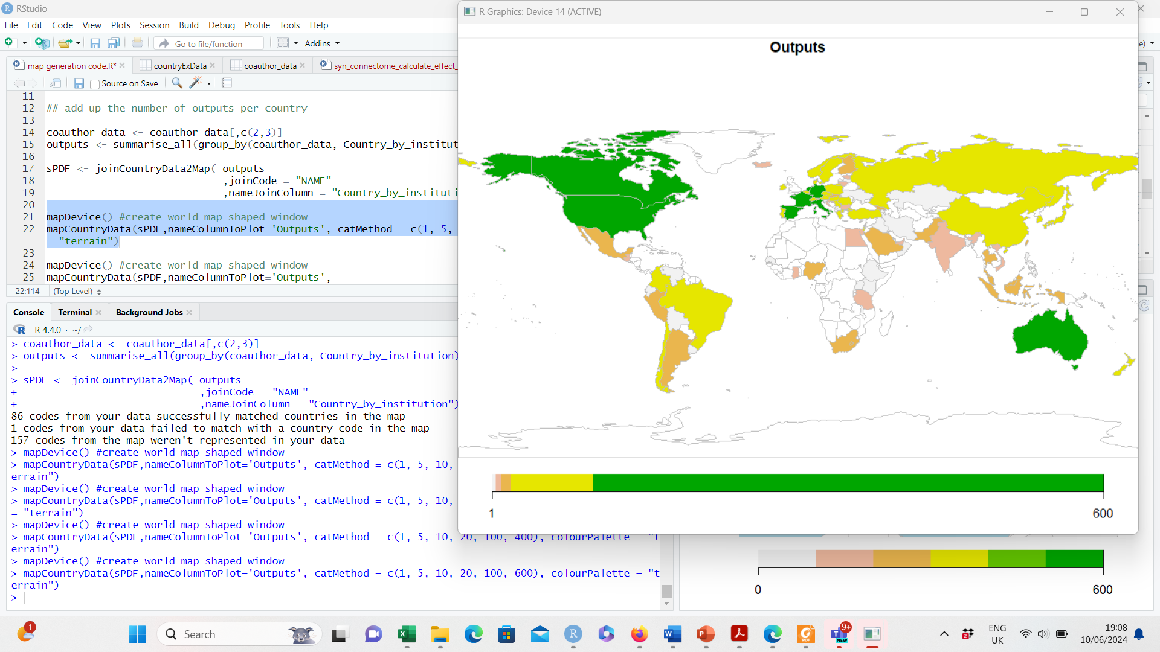

Slide 3
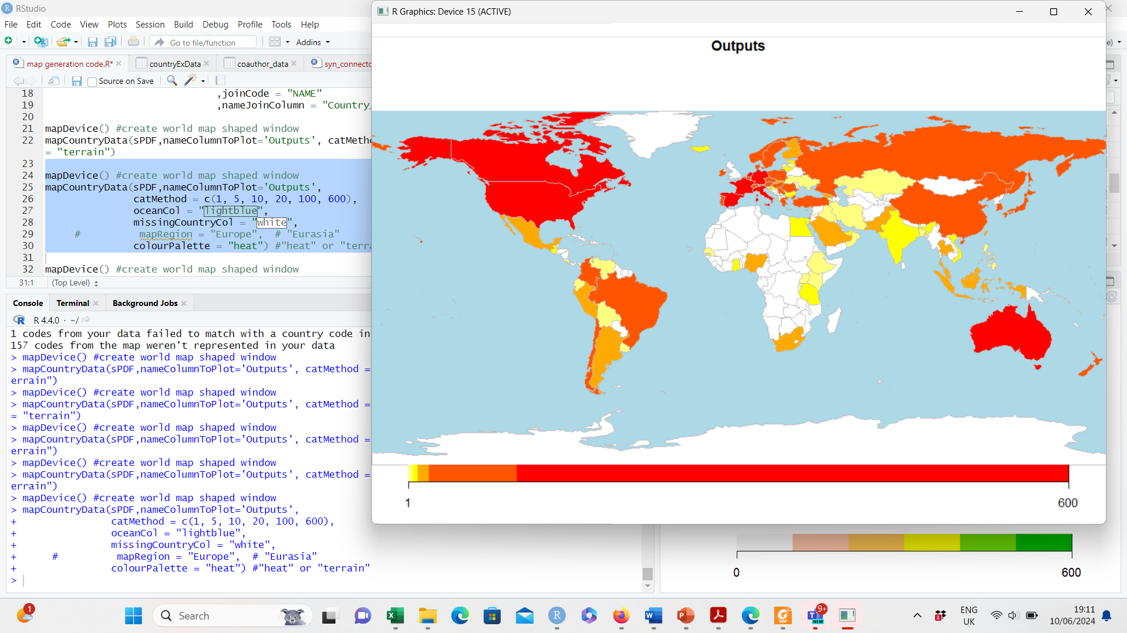

Slide 4
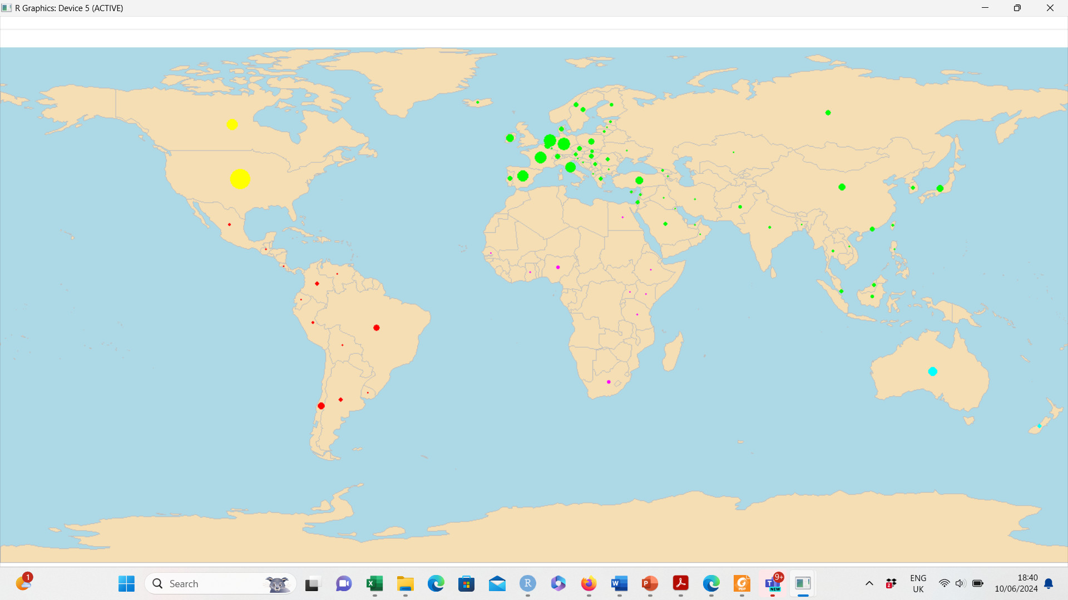

Slide 5
Number of Co-Authoring Institutions

Slide 6
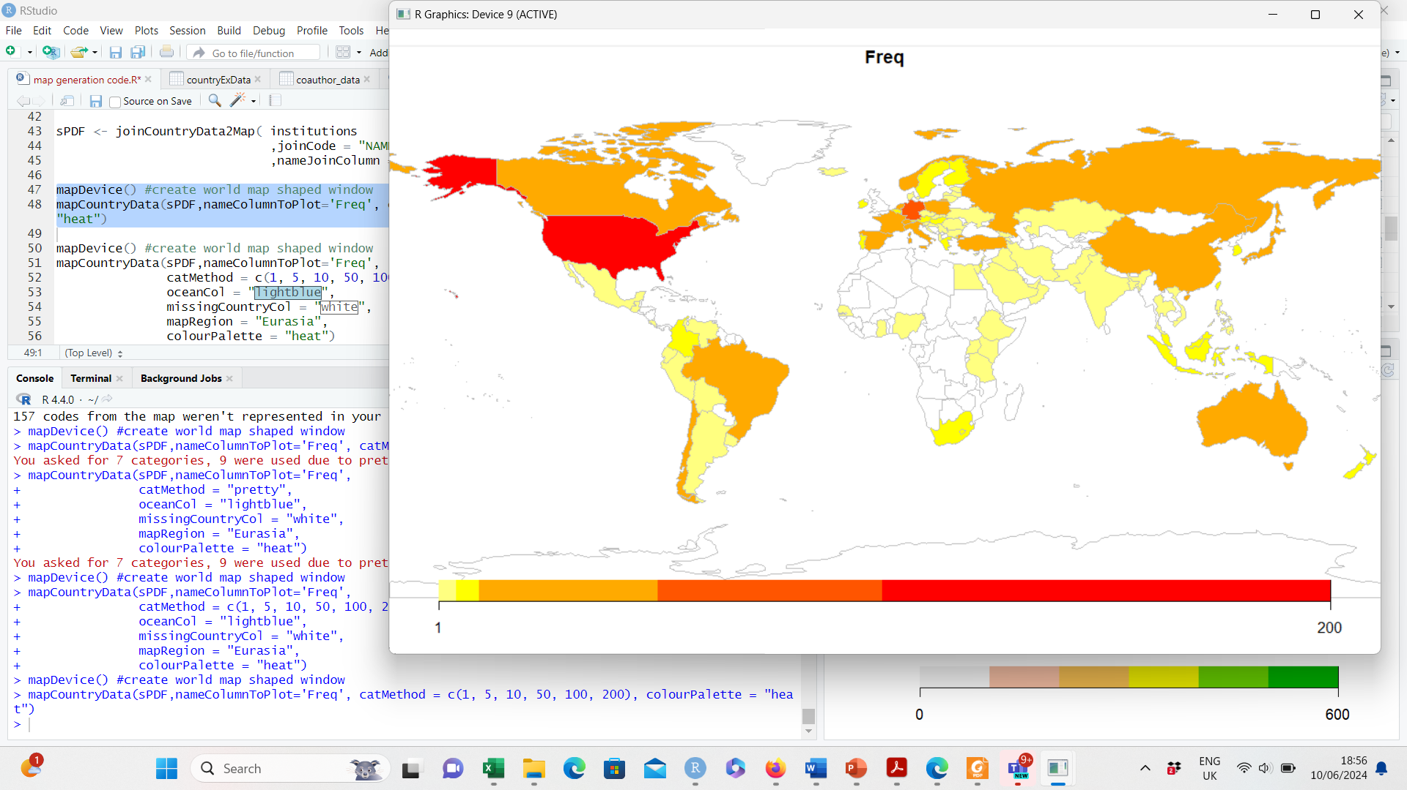

Slide 7
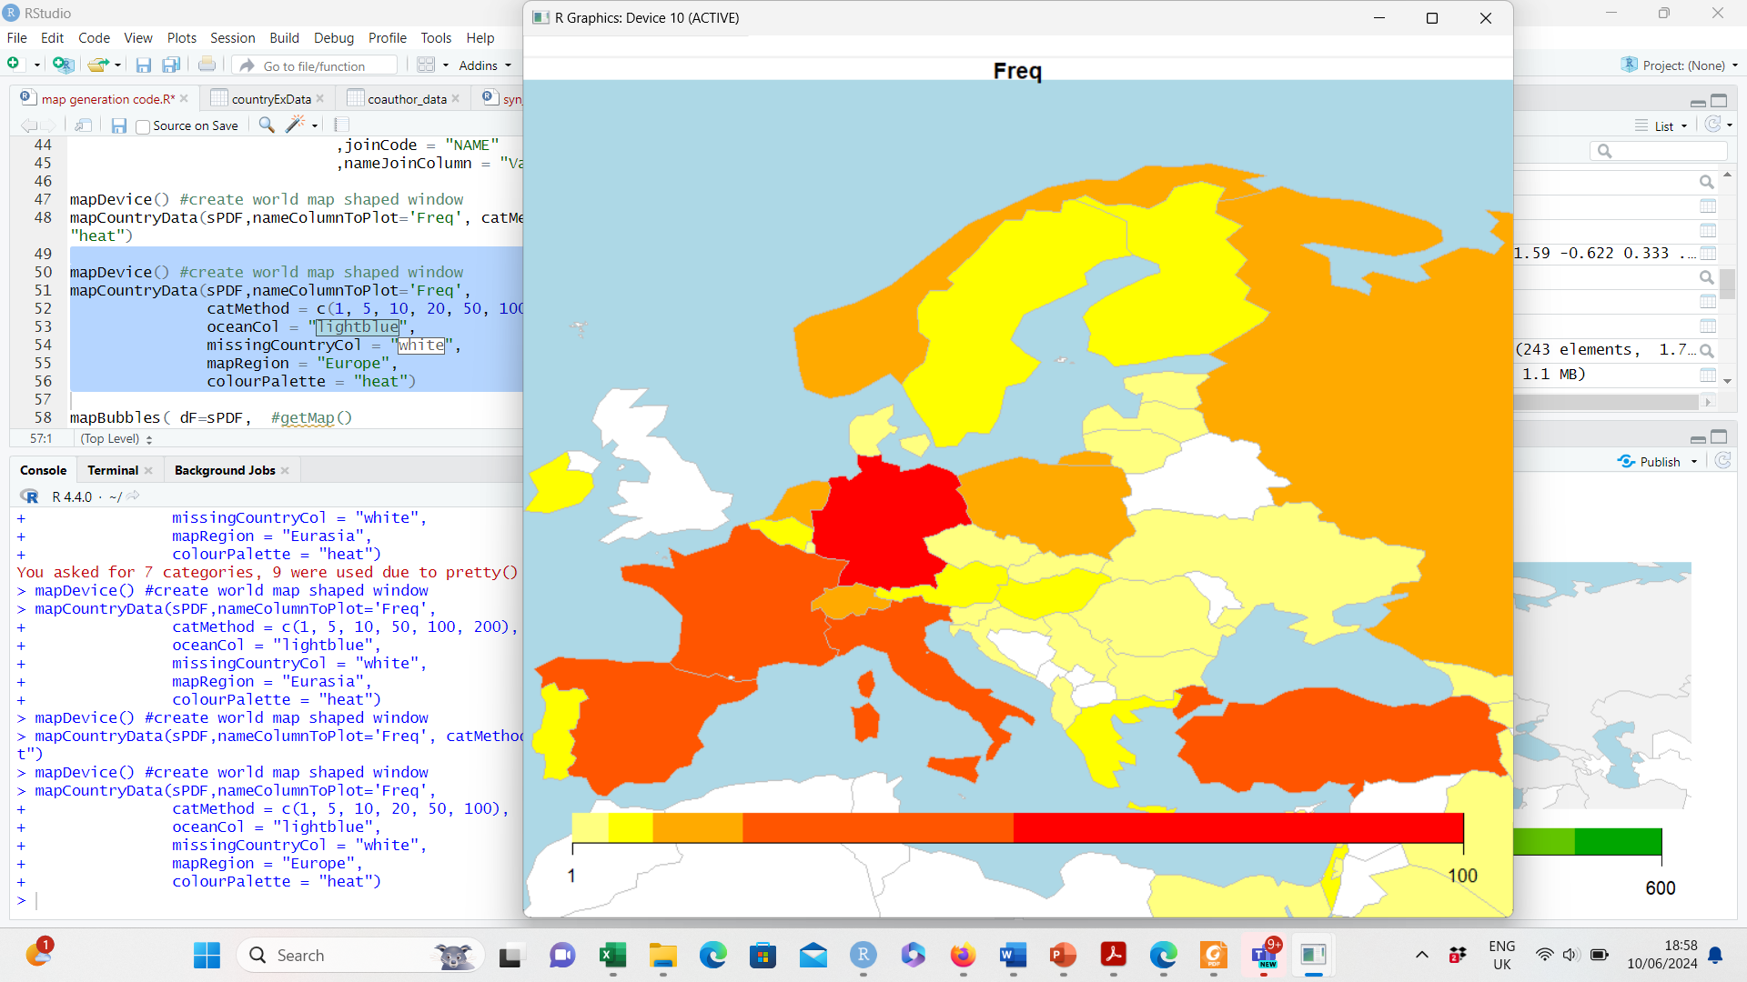

Slide 8
